Slide 1
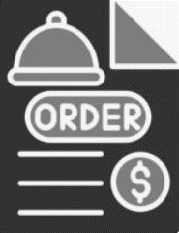
Sales Order Analysis Dashboard

Slide 2
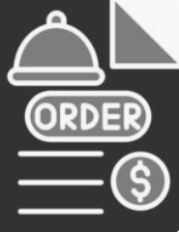
Key Requirements
Assess the total number of orders in the first quarter of year 2023.
Determine the average orders per month.
Determine the total categories in the menu.
Explore the total number of items in all categories of the menu.
How do total orders vary by month.
How do total orders vary by day of the week.
Analyze the peak hours with respect to orders.

Slide 3
Key Requirements
What is the percentage contribution of each category.
Determine the top 5 items with respect to orders and their selling price.
Determine the bottom 5 items with respect to orders and their selling price.

Slide 4
Insights
Total number of Orders Per month shows that January and March are almost receiving same number of orders but there is a drop in orders of February.
Monday is the first working day of week which is generating most of the orders i.e. 881 orders in general, while Friday and Sunday comes next to it.
It is concluded that most of the orders are placed in lunch timings i.e. in between 12 PM to 1 PM noon and after closure of routine office hours i.e. in between 5 PM to 6 PM.
Top most ordered items include Edamame, Hamburger and Korean Beef Bowl with prices $5, $13 and $18 respectively

Slide 5
Insights
Asian Category contributes the most to total orders of the restaurant which is about 49.32%.
Top least ordered items include Chicken Tacos, Pot stickers and Cheese Lasagna and their prices are $11.95, $9 and $15.5 respectively.

Slide 6
Recommendations
Inventory of highest selling items should be maintained specially during peak hours of the day i.e. between 12 PM to 1 PM noon and then then after closure of routine office hours i.e. between 5 PM to 6 PM.
Different discounted deals can be offered having the combination of highest ordered items and least ordered items in order to generate more revenue from least ordered items.
Online Marketing campaigns can boost sales and increase number of orders.
Regularly review performance metrics and adjust strategies as needed for the best outcome.

Slide 7
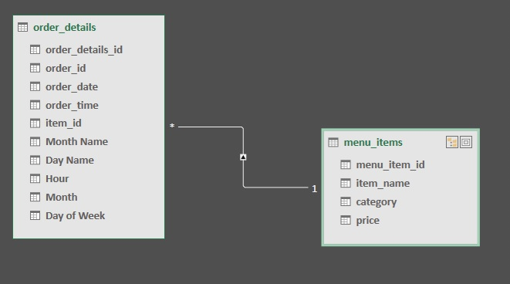
Data Model of Sales Order

Slide 8
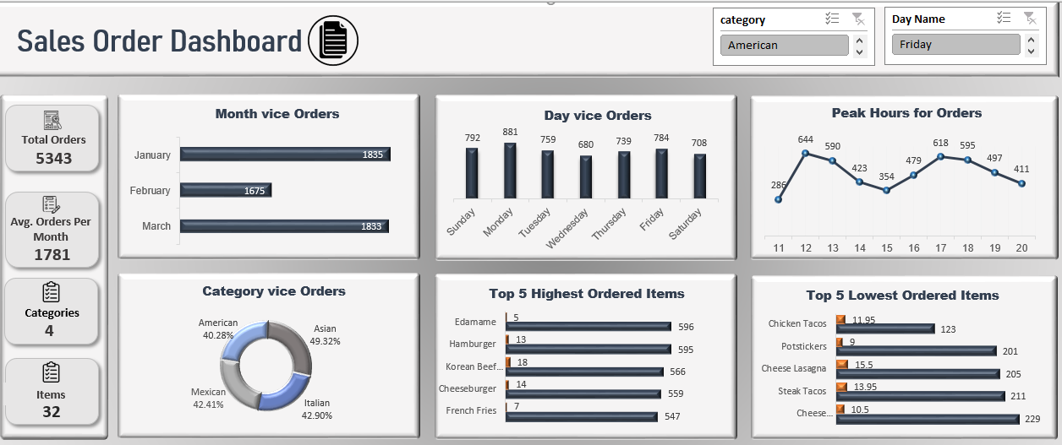
Dashboard of Sales Order

